Slide 1
Introduction to the Pre-sessions Auckland, 23rd October 2018
What is the UPR? What are the Pre-sessions? How to prepare?
What to expect?

Slide 2
UPR Info

Slide 3
UPR Info aims to…
Make the UPR process an effective mechanism to improve human rights on the ground by:
- Providing capacity-building tools and training
- Supporting engagement at all stages
- Engaging all stakeholders
- Non-advocacy NGO, except on the UPR
Notes:
We work to promote and strengthen the UPR by raising awareness, providing capacity-building tools, and bridging the different actors of the UPR.

Slide 4
What does UPR Info do?
Pre-sessions
In-country Programme
Support the engagement of different stakeholders
Strengthening the UPR process
http://www.upr-info.org/database
Notes:
In terms of who does this:
5 staff (as well as 2 interns in GVA) 3 in the Africa Regional Office Nairobi
Finacial support is mostly from States

Slide 5
Pop Quizz

Slide 6
True/False
All the UN Member States take part in the UPR process
Only full UN Member States can make recommendations
There is a word limit for the NGO submissions to the UPR
NGOs can submit as many joint submissions as they want
NGOs can take the floor during the Working Group
Notes:
2,815 words for individual submissions; 5,630 words for joint submission

Slide 7
True/False
Recommendations can either be accepted or rejected
Recommendations are legally binding for the SuR
There is no official UN mechanism in place to follow up on recommendations/implementation
On average, States receive 50 recommendations per review
There are no punishments if States refuse to implement accepted recommendations
Notes:
On average, SuR receives around 200 recommendations; RS makes 2.5 recommendations
Res 5/1: ”After exhausting all efforts to encourage a State to cooperate with the universal periodic review mechanism, the Council will address, as appropriate, cases of persistent non-cooperation with the mechanism.”

Slide 8
Introduction
Brief Introduction to the UPR
Introduction to the Pre-sessions
New Zealand: In-country Pre-session
Preparation for the Pre-sessions
Success stories from the Pre-sessions

Slide 9
Universal Periodic Review

Slide 10
Main international human rights mechanisms
Mechanism | Treaty bodies | Special Procedures | UPR
Description | International treaties setting out duties for States to protect human rights | International experts who examine human rights either thematically or by country | International human rights assessment undergone by each UN Member State every 4 ½ years
Number | 10 treaty bodies | 44 thematic; 12 country-specific | All 193 UN Member States
Foundation | 9 international human rights treaties, ratified by States | By resolution of the Human Right Council | By resolution of the UN General Assembly & Human Rights Council
Themes | Civil & political rights (CPs); Economic, social & cultural rights (ESCRs); Racial discrimination; Women; Torture; Children; Migrant workers; Disabilities; Enforced disappearances | Varied: CPs; ESCRs; collective rights (e.g. environment); marginalised groups; country mandates incl. Syria; Palestine; Myanmar… | All human rights issues can be raised in the UPR, as well as tenets of humanitarian law
Nature | Legally binding treaties; treaty bodies led by committees of independent human rights experts | Independent experts appointed by the UN; issue reports & recommendations | Inter-governmental, peer-review political process; not legally binding
Other information | Individual complaints procedure under CCPR; CERD; CAT; CEDAW; CRPD; CED; CESCR; and CRC | Mandate holder must have express permission of the State to conduct a visit | The only universal human rights mechanism, with a 100% participation rate

Slide 12
1 UPR cycle
1st cycle: 2008-2011
2nd cycle: 2012-2016
3rd cycle: 2017-2021
Notes:
All member states have been reviewed twice – so how many is that? (193)
South Sudan had its first review in the second cycle however it did recieve recs during the first cylce during the UPR of Sudan.
Who has not been reviewed but can make recommendations? (observer states Palestine/ Holy See)

Slide 13
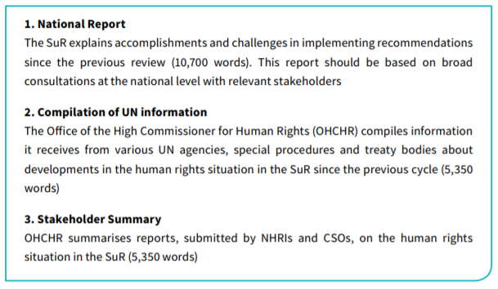
What is being examined?
The human rights situation in the SuR and its compliance with international human rights mechanisms and standards

Slide 14
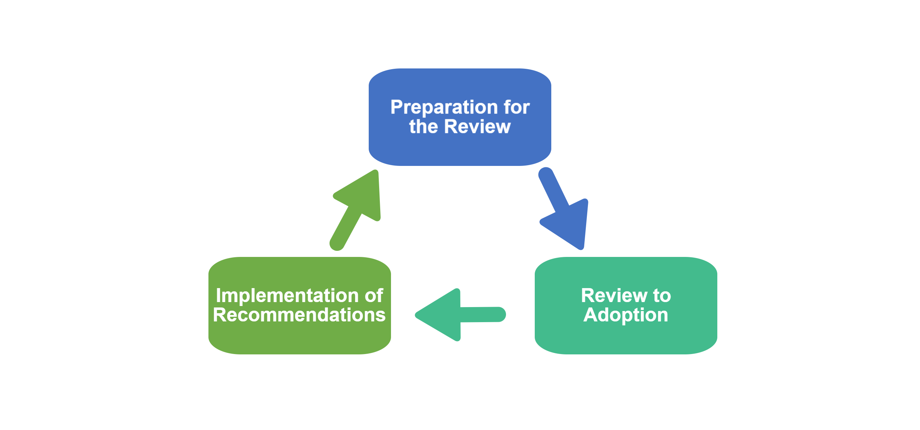
The stages of the UPR
Notes:
The UPR is a full-circle process comprising 3 key stages:
1) Preparation for the Review – reporting on implementation of those recommendations and pledges and on the human rights situation in the country since the previous review
2) Review of the human rights situation of the SuR
3) Implementation between two reviews (5 years) of the recommendations accepted and voluntary pledges and commitments by the SuR. Also midterms: reporting at midterm on the rate of implementation.
It’s a National mechanism therefore CSOs need to remain engaged throughout the cycle!

Slide 15
UPR data
All UN Member States undertake the review
174 States have made recommendations
On average, 3 recommendations per State (session 1-26)
Notes:
All member states have been reviewed twice – so how many is that? (193)
South Sudan had its first review in the second cycle however it did recieve recs during the first cylce during the UPR of Sudan.
Who has not been reviewed but can make recommendations? (observer states Palestine/ Holy See)

Slide 16
Engagement
61’014 Recommendations
Only international human rights mechanism to have 100% State participation
3rd cycle push towards implementation and effective reporting
Notes:
Before the UPR, three documents, 1) the national report submitted by the State under Review 2) the compilation of information from the UN 3) the summary of reports submitted by civil society, are available on the OHCHR website aproximately six weeks before the review itself (UPR Info also provides them on its country pages). These documents provide information about the human rights situation, including progress and challenges, since the last review. It is necessary for recommending States to read them in order to have a clear understanding of the human rights in the countries under review.
In order to prepare the statement on a country under review, States can meet with national and international civil society organisations to collect information about the human rights situation in the country and about the level of implementation of the previous recommendations. To find out the recommendations made during the previous review, check our database.
States can also attend UPR Info’s "Pre-sessions" in Geneva, Switzerland. One month before the review, we organise a one-hour meeting on the State under Review and give the floor to national and international NGOs to brief Permanent Missions about the human rights situation in the country. This allows States to receive first-hand and comprehensive information on countries and meet several NGOs at once.
States can, before the review, submit questions to the State under Review (SuR). These written questions have to be transmitted to OHCHR Secretariat (uprstates@ohchr.org) at least ten working days before the day of the review. Written questions can be an opportunity to ask about the level of implementation of the recommendations made at the previous review, or to ask for clarification about a specific human rights problem.
The troika is a group of three UN Member States that assist the State under Review. The three States can still participate in the Working Group session as normal, but the troika representatives have two main roles: (1) receive all advance questions and relay them to the State under Review and (2) help to prepare the report of the WG with the assistance of the UN Secretariat and the State under Review. One troika member is in charge of introducing the list of recommendations before its adoption in the Working Group.
The review in the Working Group consists of a 3,5h interactive dialogue between the SuR and United Nations Member States. In total, 140 minutes are given to the latter. Every State willing to speak on a specific review is able to do so. The 140 minutes are divided by the number of States interested in taking the floor. Recommending States must register to speak at the reviews. Registration opens at 10:00 am on the Monday and closes at 6:00 pm on the Thursday during the week prior to the Working Group session. A registration desk is installed in Palais des Nations and the OHCHR Secretariat notifies Permanent Missions of its location. It is important to register during those four days, otherwise States will not be allowed to take the floor. The lists of speakers for the 14 reviews of a given Working Group session open the week before the beginning of the session and States have four days to register. Then, each list is arranged in English alphabetical order and the HRC President chooses the first speaker by lot. The list continues from that speaker in alphabetical order. States are able to swap place on the list. Those wishing to withdraw from a list have to inform the Secretariat at least 30 minutes before the beginning of the review to allow the latter to recalculate the speaking time provided to each delegation. If a Recommending State is not present when it is due to speak, it may be possible to speak at the end of the review (the OHCHR Secretariat should be informed if this is the case). During the Working Group session, the Recommending States take the floor to read their prepared statements. Unless already submitted to the OHCHR Secretariat in electronic form, Recommending States should bring an additional copy of the statement for officers of conference services and interpreters. It should be noted that any recommendations that are not read in the room will not be included in the Working Group report. After the review of a State in the Working Group, the list of recommendations is finalised by the Secretariat with the support of the troika. Recommending States might be approached during the 48 hours pursuing the review by the troika to confirm the language in the recommendations. Changes to those recommendations can only be made orally at the adoption and will not be accepted afterwards. The adoption of the list of recommendations lasts 30 minutes for each country. The final full draft report, including the adopted recommendation section, is distributed by the OHCHR Secretariat one week after the end of the UPR Working Group session. Recommending States can notify the OHCHR Secretariat about any errors to their statement summary within one week by writing to uprstates@ohchr.org.
The final step in Geneva, before the implementation period begins, is for the HRC to officially adopt the Working Group report during a plenary session. During the adoption of the report, recommending States must check if the summary of their statement contained in the report is accurately reflected and if the recommendations they made have been included with the correct wording:
- Editorial changes to summaries of statements should be brought by writing to the Secretariat (uprstates [at] ohchr.org) within two weeks after the end of the Working Group session.
- Changes to recommendations can be brought solely orally during the adoption of the Report at the Working Group stage.
During the adoption of the report at the Human Rights Council session stage, States can use this opportunity to ask for responses to recommendations or clarifications on them.
The adoption only lasts for one hour per country, divided in three segments of 20 minutes between the State under Review, civil society and Recommending States. Registration for the latters begins on Monday of the week before the UPR segment of the HRC session and is open until Thursday. The list of speakers is in alphabetical order, with the first speaker drawn by lot and the list proceeding alphabetically from that point. The speaking time for each speaker depends on the number of States registered, but with a minimum of 90 seconds each, which usually allows for 13 States to take the floor. If time is left, States beyond the 13th on the list are given the floor within the 20 minutes.
Recommending States take the floor at the adoption of the final Working Group report in the HRC in order to: - Ask for clarification of the State under Review´s responses to recommendations; - Express regret or concern that certain recommendations that the State under Review has wrongfully indicated as "already implemented or in the process of implementation" and - Encourage implementation of recommendations. The Recommending State can also express its readiness to assist the State under Review with the implementation of specific recommendations. The final Working Group report is always adopted by the HRC by consensus.
Through their embassies, development agencies and local partners, States should monitor the implementation of the recommendations they made. When needed and possible, they should provide support, financial or technical, to the Government and other actors such as civil society in this regard.

Slide 17
Shortcomings
No official follow-up mechanism
No fund for CSOs
Vague recommendations (36% specific <S26)
Takes place every 4 ½ years, limited space for subsequent discussions at the international level
Notes:
All member states have been reviewed twice – so how many is that? (193)
South Sudan had its first review in the second cycle however it did recieve recs during the first cylce during the UPR of Sudan.
Who has not been reviewed but can make recommendations? (observer states Palestine/ Holy See)

Slide 18
New Zealand at the UPR

Slide 19
New Zealand

Slide 20
New Zealand
79 States made 228 recommendations to New Zealand (all UPR reviews)
New Zealand accepted 159 reccommendations out of 228 received in total
58 recommendations received by New Zealand containd a specific action (category 5)

Slide 21
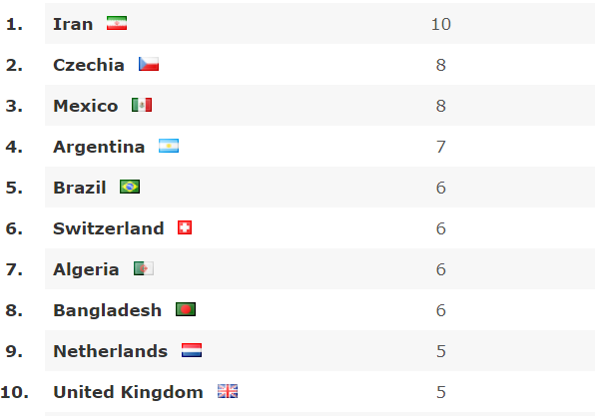
New Zealand’s top 10 Recommending States

Slide 22
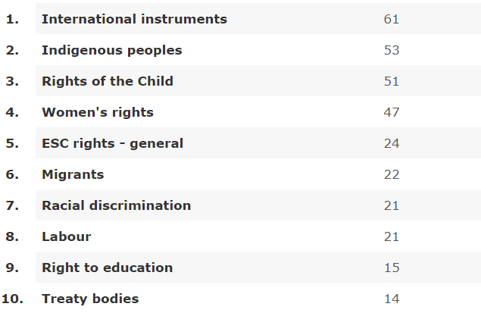
New Zealand’s top 10 issues addressed in received recs

Slide 23
Pre-sessions

Slide 24
Pre-sessions: Inception
Formal UPR structure limited the extent to which civil society could engage dynamically with the process:
CSO submissions sent to the OHCHR 6-7 months in advance of the State’s review -> information gap on new human rights developments
Limited word count of CSO submissions
Information summarised by OHCHR (10 pages in total)
CSOs not allowed to take the floor during the review
Notes:
Why UPR Info has developed the Pre-sessions? Even though the Human Rights Council has formally acknowledged the important role of CSOs in the UPR process, the formal structure limited the extent to which civil society could engage directly and dynamically with the process.
Why is this access limited? CSOs can engage with the UPR process by submitting a report to the OHCHR

Slide 25
Pre-sessions: Inception
UPR Info introduced the Pre-sessions in 2012 to serve a dual aim:
Supporting bottom-up advocacy at the UPR
To offer civil society & national human rights institutions an international platform to directly advocate to State delegations ahead of the UPR
Providing State delegations with first-hand sources of information
Compared with having to read all UPR submissions, States can engage directly with the HR experts e.g. the national NGOs
Notes:
Ultimate objective of the Pre-session for the civil society is that your recommendations are reflected, picked up by State delegations at the actual UPR review, so your recommendations are made to New Zealand in January by State representatives in Geneva.

Slide 26
In-country Pre-sessions
Aim: to provide a national platform for local civil society to brief the resident diplomatic community and the media on pressing human rights issues.
These national human rights conferences reinforce the message that the civil society organisations (CSOs) will make in Geneva.
gives further weight to the human rights issues that can be shared by the diplomats in attendance with both their State capitals and counterparts in their Geneva-based Permanent Missions to the United Nations
Notes:
We work to promote and strengthen the UPR by raising awareness, providing capacity-building tools, and bridging the different actors of the UPR.

Slide 27
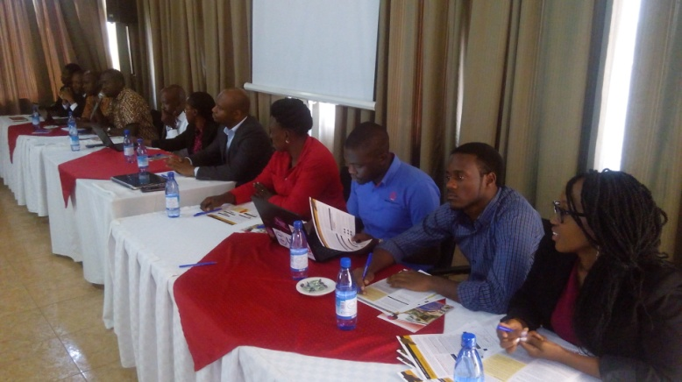
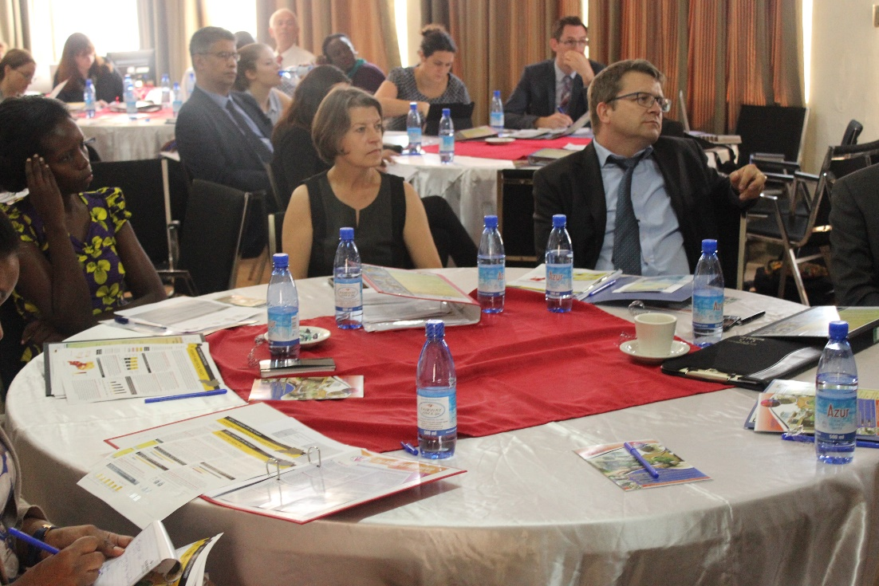
In-country Pre-sessions
Since 2015, UPR Info has been supporting In-country Pre-sessions in:
Myanmar
Thailand
Tanzania
Uganda
Ghana
Botswana
Sri Lanka
India
Jordan
and ...
New Zealand
Notes:
We work to promote and strengthen the UPR by raising awareness, providing capacity-building tools, and bridging the different actors of the UPR.

Slide 28
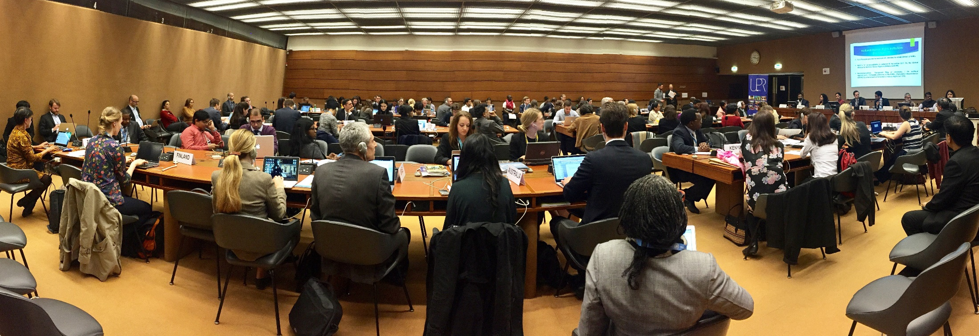
Geneva Pre-sessions
- Held at the United Nations, Geneva
- Second cycle statistics (2012-2016):
Pre-sessions organised on 149 States
150 State delegations (Permanent Missions) in attendance
467 national CSO speakers
206 international CSO speakers 52% women/48% men
33 NHRIs
Notes:
From 2012 until October 2018: UPR Info organised Pre-sessions on 210 States, bringing 524 national NGOs to Geneva. At the Pre-sessions 31, we had an average of 38 PM attending each Pre-session.

Slide 29
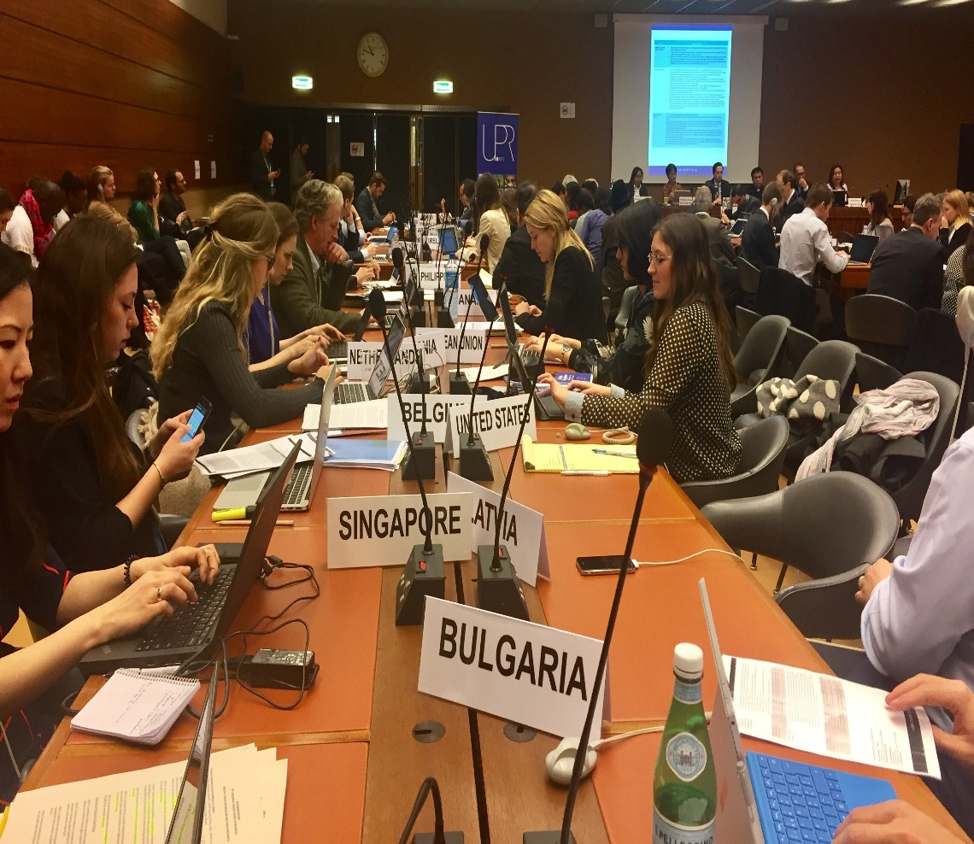
Geneva Pre-sessions
Speaker selection
Priority is given to:
Grassroots/national CSOs
National coalitions
CSOs that have submitted UPR report
Broad representation of HR issues
Gender balance
Modalities
1 hour per country
English or French
5 to 6 speakers (max.)
6 to 7 minutes/speaker
Power Point encouraged: 6-8 slides (max.)
Copies of statements/factsheets for distribution to State delegations
Arrange bilateral meeting with State delegations at the UN
Notes:
We work to promote and strengthen the UPR by raising awareness, providing capacity-building tools, and bridging the different actors of the UPR.

Slide 30
Geneva Pre-sessions
Pre-session on New Zealand
11-14 December 2018 in Geneva
Apply online ! Go to the front page of our website: www.upr-info.org, scroll down to the Pre-session news and click on the link to the online form.
Deadline to apply has been extended to New Zealand until Sunday 28th October 2018.
Notes:
Extended to New Zealand because of the in-country Pre-session.

Slide 31
New Zealand
In-country Pre-session

Slide 32
In-country Pre-session:
Wellington
Date: Friday, 26 October 2018
Time: 9:00 am – 12:30 pm
Location: St Andrews Centre, the Terrace, Wellington
Audience: Diplomatic representation from embassies in Wellington
Format:
Panel with moderators
14 speakers:
7 speakers in first session [09:30-10:15] (5 minute technical break to change speakers )
7 speakers in second session [10:20-11:05]
Each speaker has 5 minutes for initial presentation
After all speakers in each session have made their presentations, moderator will open the floor for questions from the diplomats [15 mins]
Moderator may ask panel a question/concluding comment on expectations for the 3rd UPR cycle of New Zealand
At conclusion of panel, all Pre-session participants to join human rights café to continue discussion with diplomats
Notes:
Complementarity between the in-country Pre-session and the Geneva Pre-session because in Geneva, you have the State delegations to the UN which are specialised in human rights, but not country-specific (mainly issue-specific according to their priority issues), whereas in Wellington, you have the residents diplomats which are more aware of New Zealand’s national context and relations between their country and New Zealand.

Slide 33
Human Rights Café
11:15 – 12:15
After the panel has concluded, all participants will divide between three tables:
Economic, social and cultural rights
At risk and or marginalised groups
Civil and political rights
CSOs remain at their thematic tables, while diplomats circulate between the three tables, changing every 20 minutes
The purpose of the human rights café is two-fold:
To provide an opportunity for diplomats to ask for further clarification and make comments on the presentations
To jointly discuss how stakeholders can work together to achieve an inclusive and sustainable UPR process
Remember: this is a prime opportunity for you to exchange contact details with the diplomatic delegations. Follow-up by email after the meeting, and also ask to be put in touch with their colleagues in Geneva
Notes:
We work to promote and strengthen the UPR by raising awareness, providing capacity-building tools, and bridging the different actors of the UPR.

Slide 34
in-country Pre-session
Cuba
South Africa
Saudi Arabia
Samoa
Australia
Philippines
Hungary
UAE
Italy
Netherlands
Mexico
Vanuatu
Kuwait
European Union
Holy See
Canada
Spain
Iran (Islamic Republic of)
Chile
Egypt
Pakistan
Thailand
Singapore
France
Timor-Leste
Argentina
Turkey
United States
Fiji

Slide 35
In-country Pre-session:
Preparations

Slide 36
Preparations
Arrive in good time
Bring business cards
Bring advocacy material (factsheets)
Strict time limitations
Reflect on potential questions and mentally prepare responses
Organise bilateral meetings with Country representatives
Notes:
Arrive at the Pre-session in good time so that you can settle in and find your place on the panel
Bring business cards to exchange with the diplomatic representations
When you are delivering your presentation, refer to what factsheet it relates to
In the interests of fairness and efficiency, time limitations are strict: 6 minutes per speaker. Practice your presentation several times in advance to make sure it can be delivered in the allotted time. When there is one minute left of your time, the moderator will pass you a piece of paper to inform you.
Reflect on what type of potential questions the diplomats may ask you in relation to your topic; mentally prepare the responses

Slide 37
Presentations
Share some key information and recommendations
Make your presentation as engaging as possible: eye contact with the audience and speaking at a reasonable pace
Use a Power Point presentation to highlight the main issues raised in a statement, i.e. suggested recommendations -
6 to 8 slides max.
Notes:
The aim of your presentation is not to read your organisation’s UPR submission in its entirety, but to share some key information and recommendations
Try to make your presentation as engaging as possible by making eye contact with the audience and speaking at a reasonable pace
It is strongly encouraged to use a Power Point presentation to highlight the main issues raised in a statement, i.e. suggested recommendations
However, with Power Point, bear in mind the following:
Only use Power Point if you feel comfortable to do so
For 6 minutes speaking time, you should have no more than 6 slides of content
Do not overload the slides with too much text

Slide 38
Structuring the presentation
Step 1): Brief introduction of the your organisation: whether part of coalition/engagement with UPR so far/how was the organisation’s UPR report drafted, etc.
Step 2): Succinct explanation of whether the Government organised national consultations in preparation of the national report
Step 3): Brief presentation of the plan of your statement. Indicate the type and number of issues you will discuss (refer to the relevant factsheet)
Step 4): For the presentation of each individual issue, structure as follows:
Give an update on the recommendations from previous reviews dealing with this issue (highlight what countries made these recs)
Describe how the situation on that issue has evolved since the last review; highlight achievements as well as remaining challenges
Suggest two or three SMART recommendations, as well as advance questions
Notes:
We work to promote and strengthen the UPR by raising awareness, providing capacity-building tools, and bridging the different actors of the UPR.

Slide 39
Coordination
Speak With One Voice
Demonstrate unity. You share the joint objective of improving the human rights situation in New Zealand. The Pre-session is a platform to channel this message!
Coordinate with your colleagues in the panel so that all core human rights issues are covered
Optimise presentations by avoiding overlap
Liaise with panellist to harmonise presentation. Conflicting information/statistics undermines your advocacy objectives as states will be less likely to use the information.

Slide 40
Pre-sessions
Success stories

Slide 41
Successful civil society advocacy
at the Pre-sessions
Notes:
Nepali CSOs recommended to reform the narrow definition of rape which included a 35-day sttute of limitation for reporting. Four states picked up this specific recommendation and Nepal extended the timeframe to 180 days.

Slide 42
Successful civil society advocacy
at the Pre-sessions
Notes:
Strategic advocacy in the second cycle of the UPR to highlight the situation of the indigenous Batwa people in Rwanda resulted in an increased number of recommendations addressing the topic compared to the first cycle. It demonstrates that the UPR can be utilized to raise the profile of a specific theme and introduce emerging issues.

Slide 43
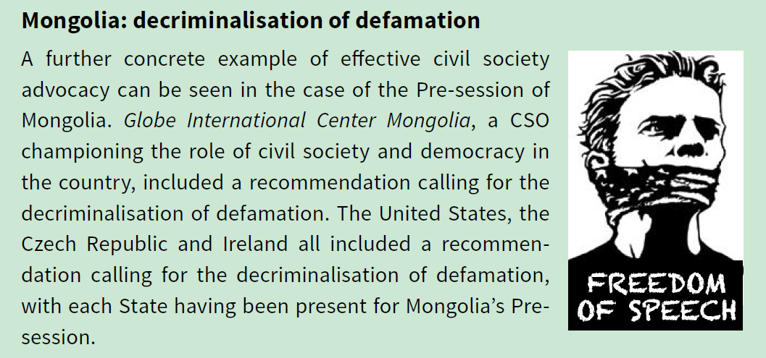
Successful civil society advocacy
at the Pre-sessions
Notes:
A Mongolian CSO utilised the advocacy platform presented by the UPR to lobby for the specific goal of decriminalization of defamation. The US, Ireland and the Czech Republic participated in Mongolia’s Pre-session in Geneve and subsequently made the recommendation at Mongolia’s review.

Slide 44
GOOD LUCK! ☺

Slide 45
n.arupova@upr-info.org
programmes@upr-info.org

